Slide 1




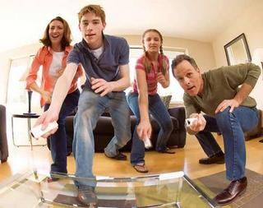
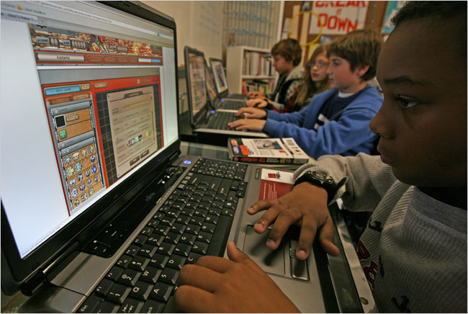

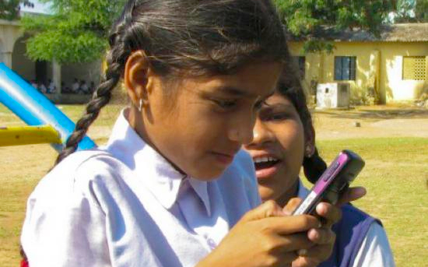
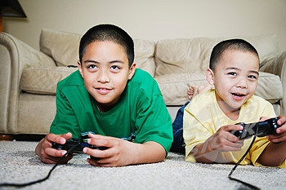
Center for
Games & Impact
in partnership with

Slide 2
Whereas young people become accomplished in geometry and mathematics, and wise within these limits, prudent young people do not seem to be found. The reason is that prudence is concerned with particulars as well as universals, and particulars become known from experience, but a young person lacks experience...
(Nichomachean Ethics 1142 a).
Guiding Question:
How do we build experience with particulars in the context of K-12 schools?

Slide 3


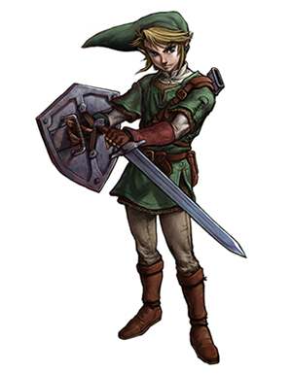
Videogames as 21st Century Curricula
Videogames offer ….
entire worlds in which learners are central, important, active participants;
a place where the actions one takes has a significant impact on the world;
and a place in which what you know is directly
related to what you are able to do and,
ultimately, who you become.

Slide 4
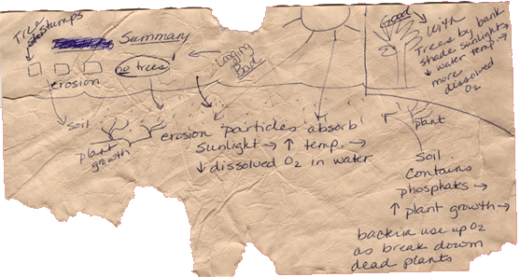
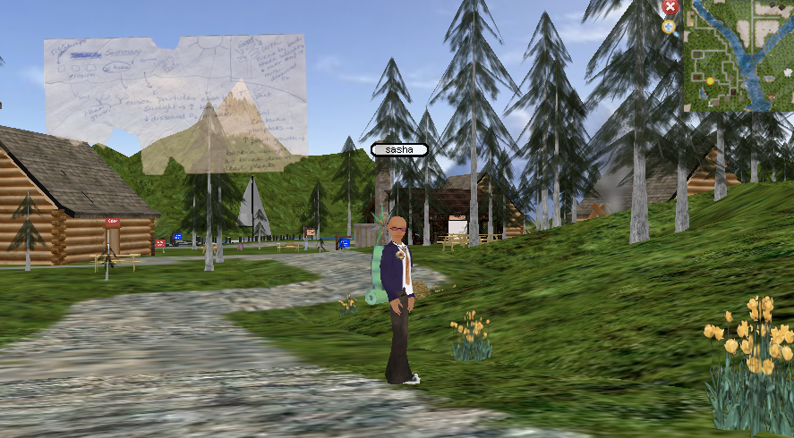
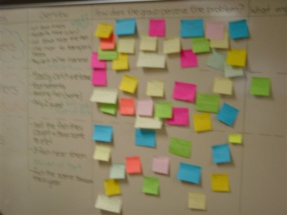
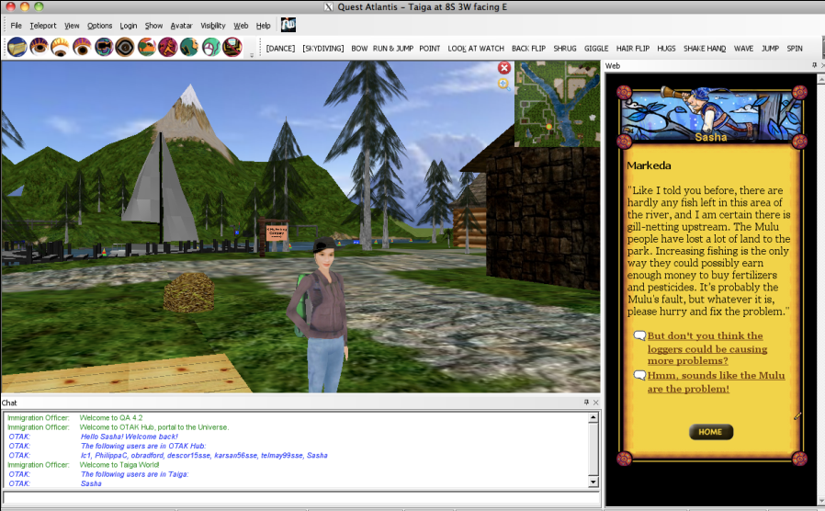

Erosion: The mechanical process of wearing or grinding something down (as by particles washing over it)

Slide 5
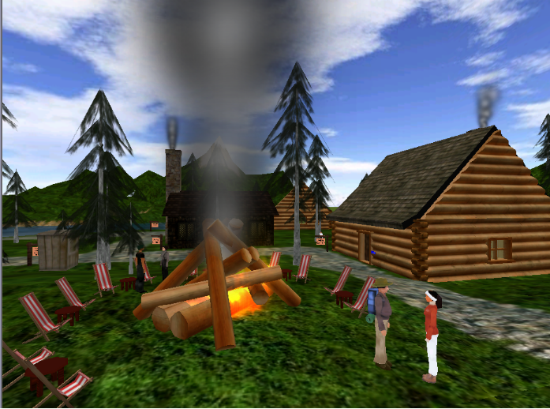
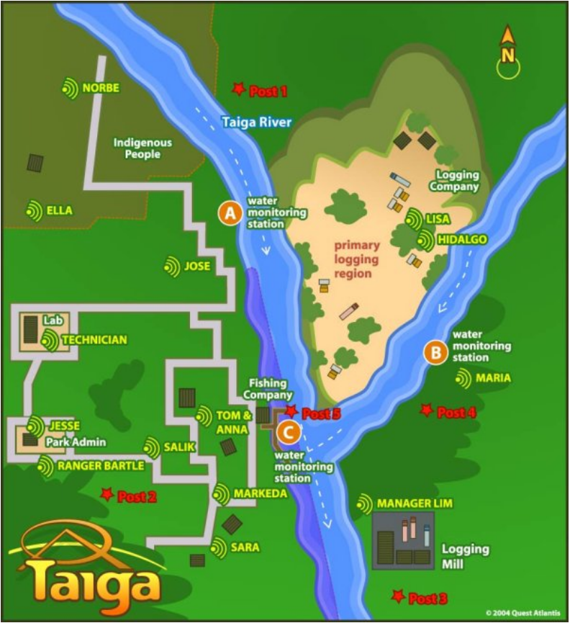
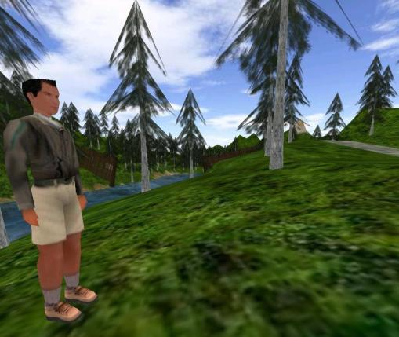
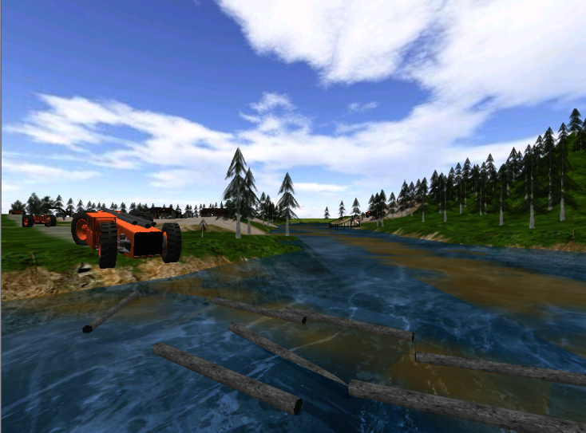
Sport
Fishing Outfit
Indigenous Farmers
A
B
C
Turbidity
6
27
22
Dissolved Oxygen
5.5
4.5
4.0
Temperature
17.5
22.5
22.0
Nitrates
3.15
0.96
2.08
Logging Company
Phosphates
3.6
1.7
3.1
pH
6.6
7.0
7.3

Slide 6
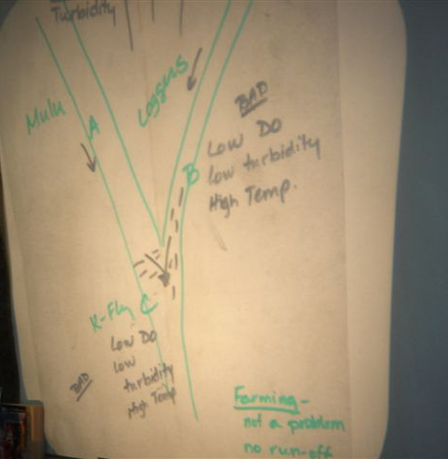
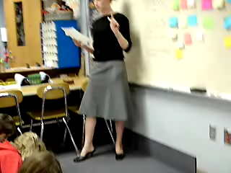
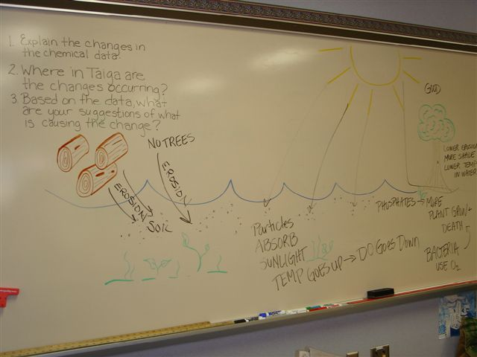
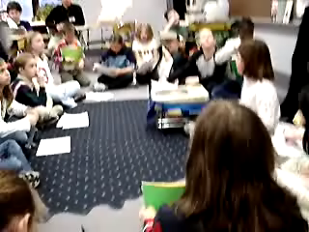
Teacher Support

Slide 7
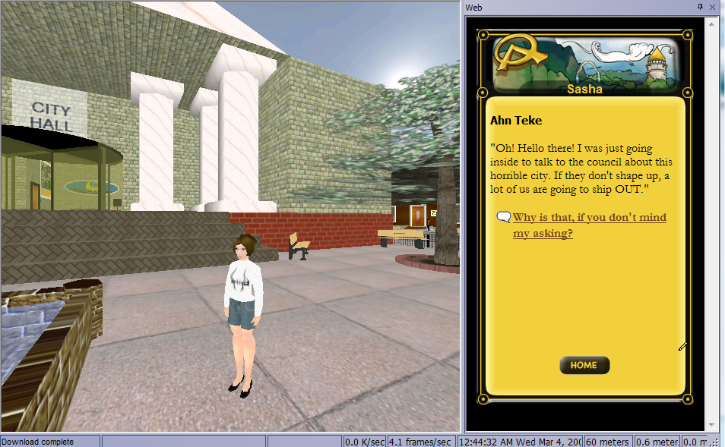
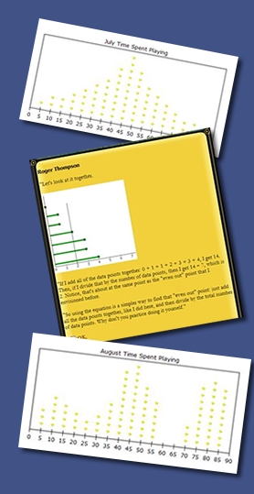
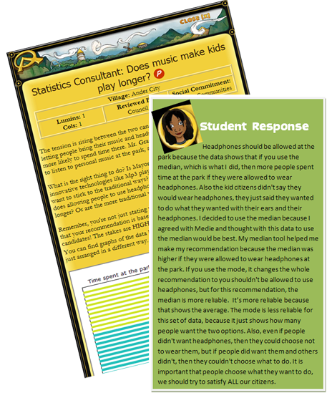
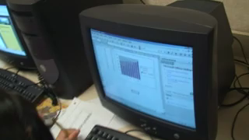
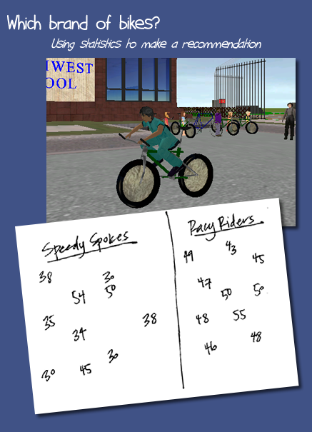
sas
Stats Unit

Slide 8
Modes of Engagement
Procedural engagement: using procedures or formalisms accurately
Conceptual engagement: knowing what to do and why it makes sense
Consequential engagement: connecting tool use to implications
Critical engagement: interrogating the usefulness, or significance of the use of particular tools on outcomes
Gresalfi, M. S., Barab, S. A., Siyahhan, S., & Christensen, T. (2009). Virtual worlds, conceptual understanding, and me: Designing for Critical engagement. On the Horizon (online journal), 17(1), 21-34.

Slide 9
Videogames as 21st Century Curricula
Videogames offer ….
entire worlds in which learners are central, important, active participants;
a place where the actions one takes has a significant impact on the world;
and a place in which what you know is directly
related to what you are able to do and,
ultimately, who you become.
“a communicative action or activity involving two parties or things that reciprocally affect or influence each other—changing both.”

Slide 10
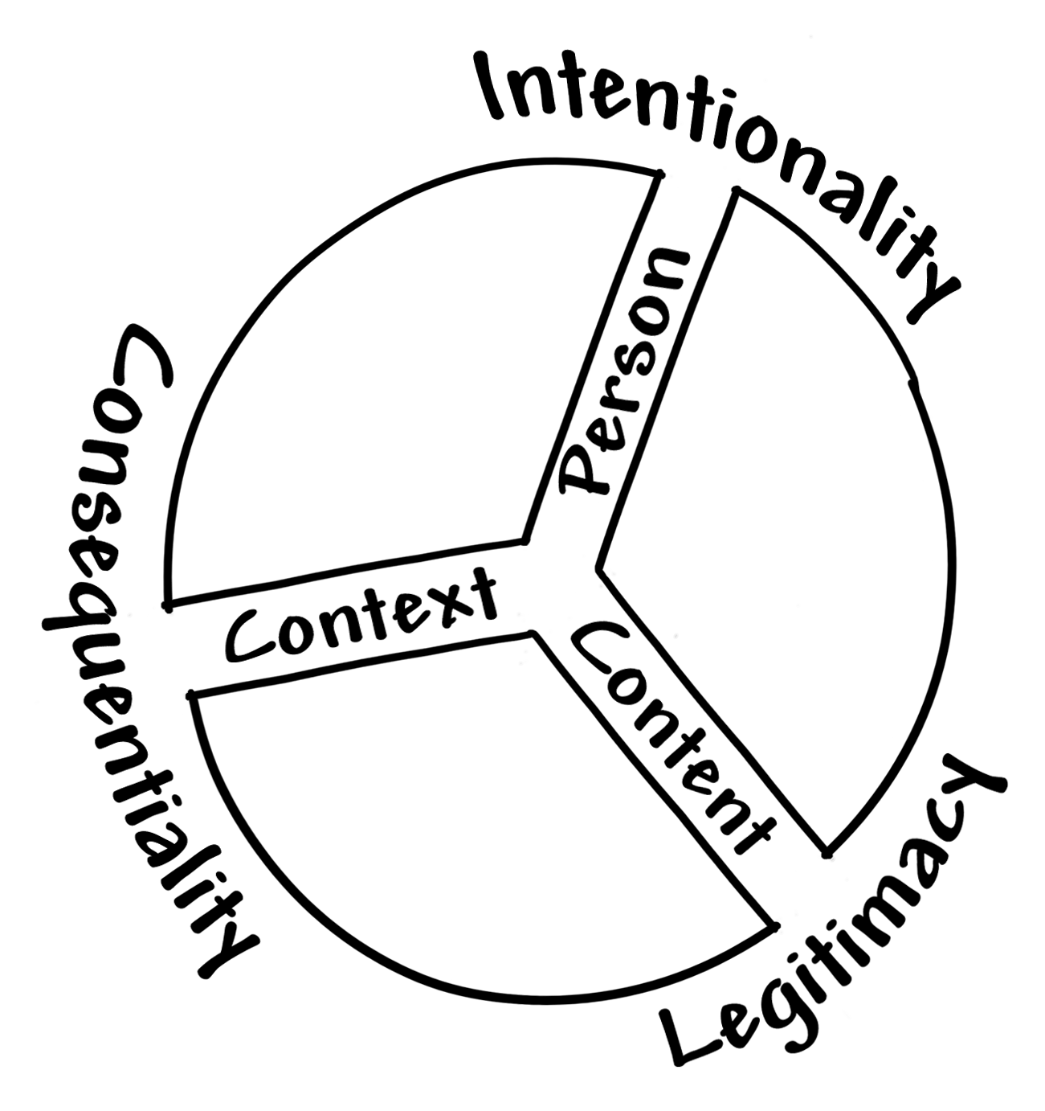
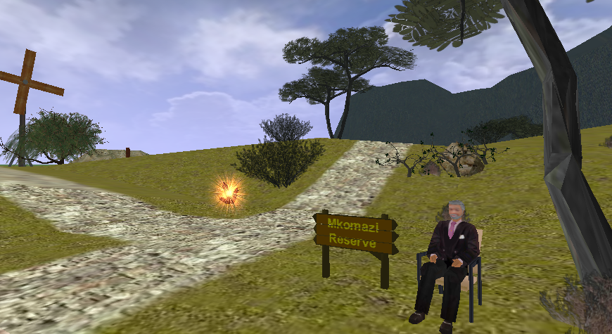
Transformational Play
The design goal is to position:
context as places where individuals make decisions that have consequential impact,
content as legitimate tools necessary for understanding and transforming these problematic situations; and
persons as change agents with intentionality as first-person protagonist responsible for the change.
… an experiential state that involves:
  (a) projection into the role of a character who,
  (b) is invited into a partly fantastical problematic context,
  (c) must apply conceptual understandings,
  (d) to transform the context,
  (e) and, ultimately, oneself.

Slide 11
Transformational Play
The design goal is to position:
context as places where individuals make decisions that have consequential impact,
content as legitimate tools necessary for understanding and transforming these problematic situations; and
persons as change agents with intentionality as first-person protagonist responsible for the change.
Person → Role
Content → Activity
Context → System
… an experiential state that involves:
  (a) projection into the role of a character who,
  (b) is invited into a partly fantastical problematic context,
  (c) must apply conceptual understandings,
  (d) to transform the context,
  (e) and, ultimately, oneself.

Slide 12
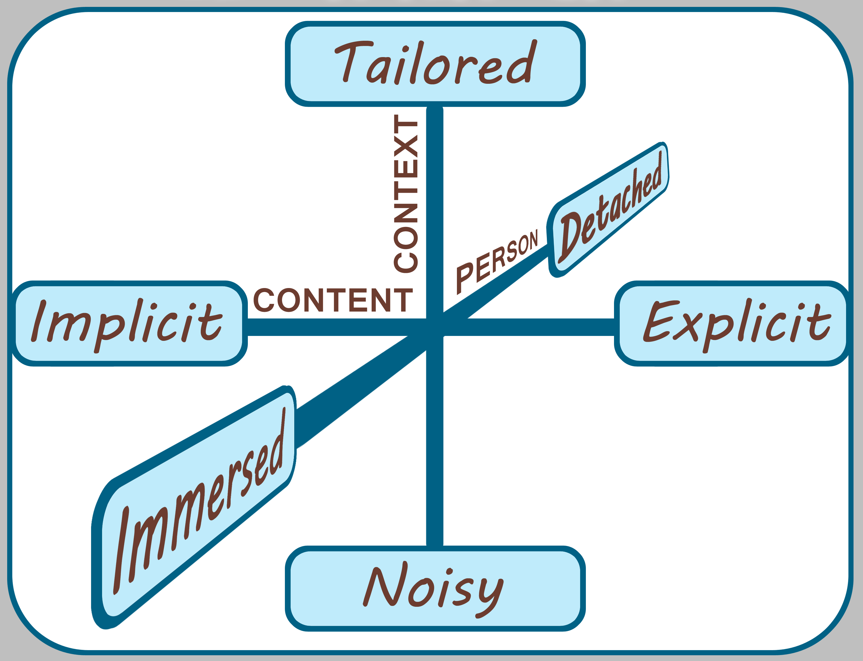
Design Tensions

Slide 13
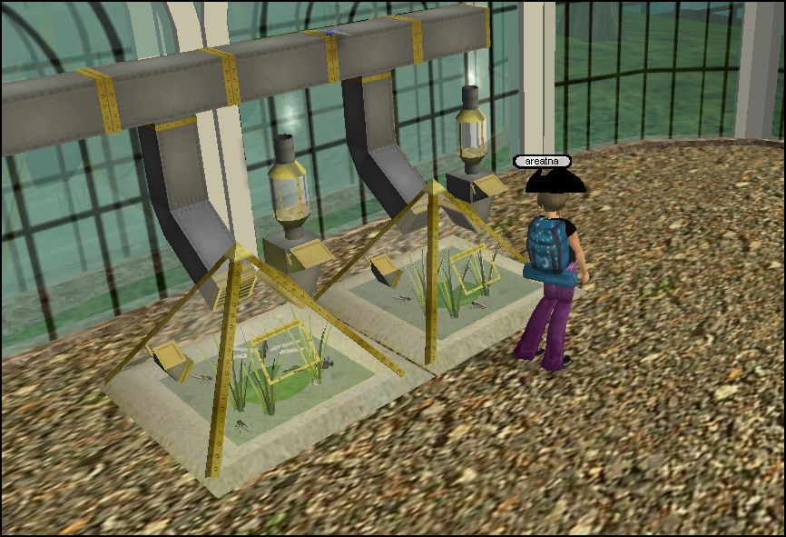
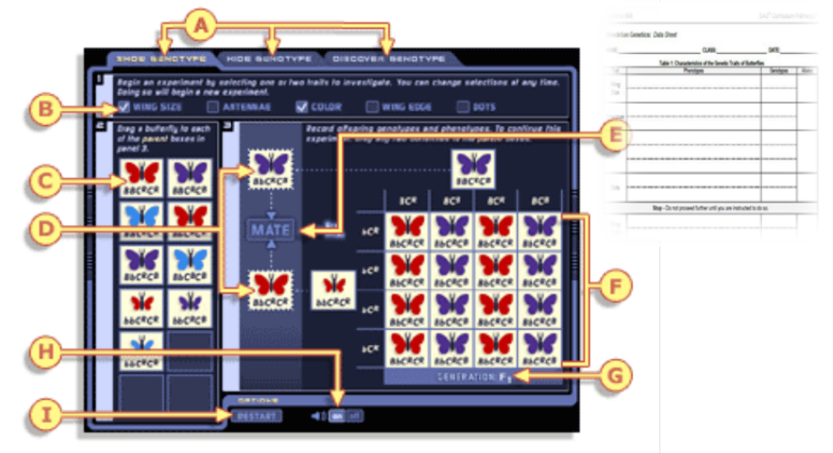
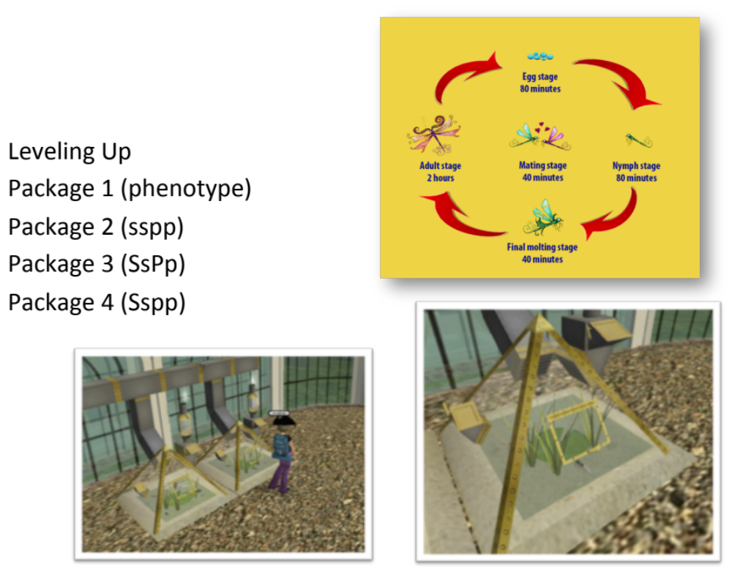
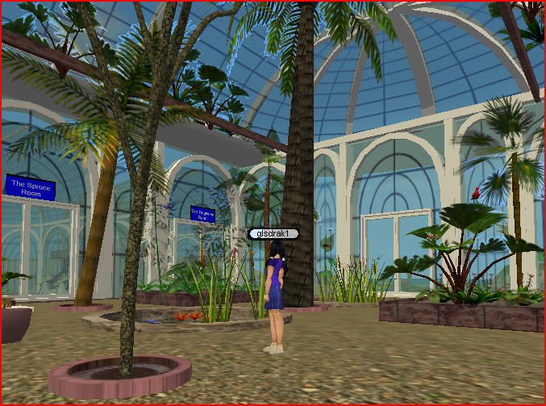
Designing a genetics game
http://www.sas.com/govedu/edu/curriculum/study-science.html
Notes:
Sasha had been asked by a company who had previously created genetic simulations how he would have done it. This is our story.

Slide 14
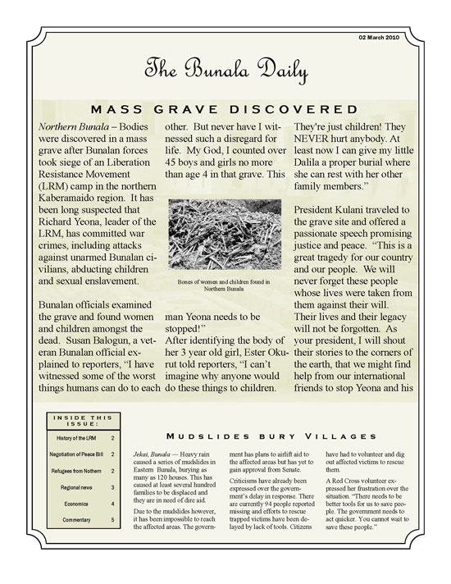
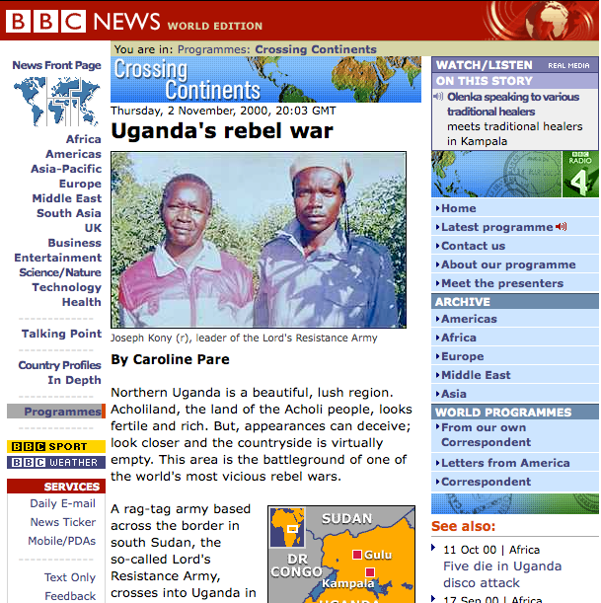
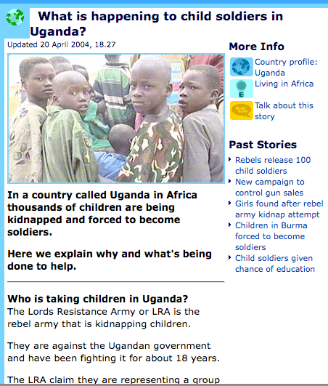
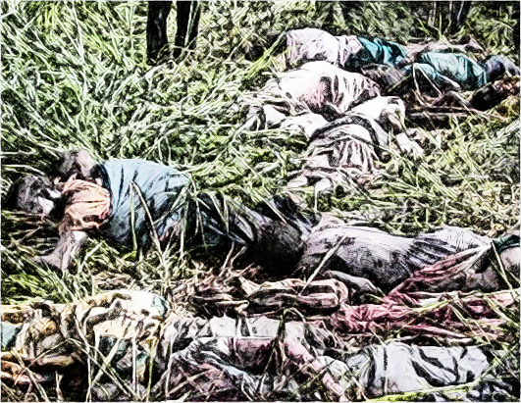
“Justice needs to be justified in terms of lives,” adding that “the [international] criminal justice system is isolated from the moral consequences of its intervention”
LRA has Killed Millions
Created Invisible Children
President Museveni Requested Help
ICC Ruled Crimes Against Humanity
LRA Promised to Stop
World said “No Peace without Justice”

Slide 15
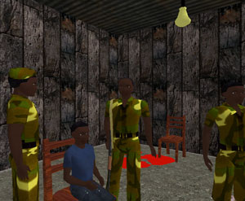
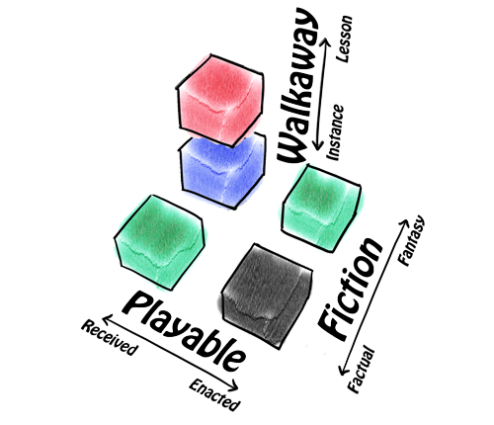
Goal for Making Playable Fiction
Beyond a simulation, our goal is to situate the player as
a decision maker,
immersed in the dramatic setting,
enmeshed in its tangle of possibilities and
experience the consequences.
To illustrate, at one point in the Uganda game:
player meets a member of the rebel army
must decide whether the member’s actions were born of necessity,
offer amnesty, justice, or forgiveness.
More than a theoretical question, the game forces the player to
experience real people caught up in the problem,
commit to a decision of possibilities,
witness the consequences of their choice,.
Making salient the player’s beliefs and biases instantiated as outcomes.

Slide 16
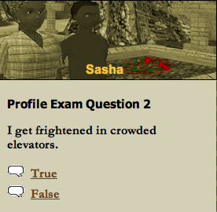
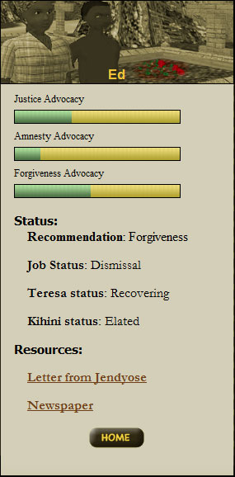
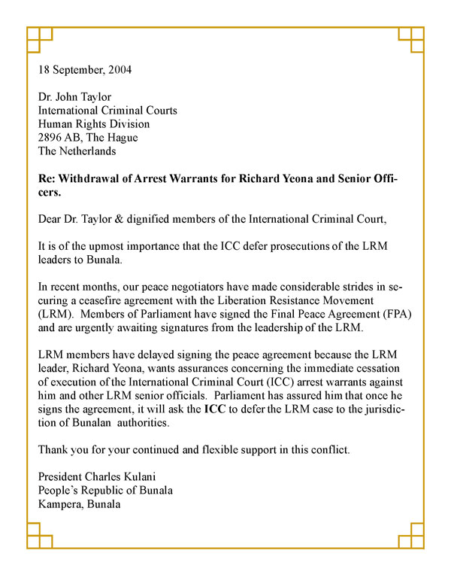
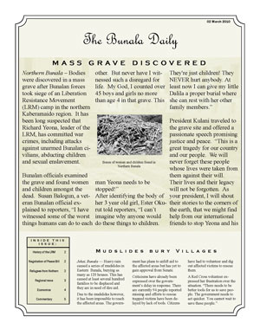
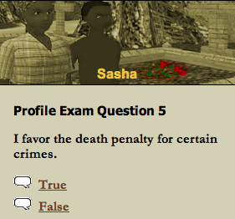
Setting the Stage
“Glad to hear it! Let’s get you through this thing. First, have a look at some documents. There’s some general information about the situation here, as well as some letters from some Bunalan citizens. More importantly, you’ll see how the Bunalan government cried for help but then tried to call it off. That’s a no-no..”

Slide 17
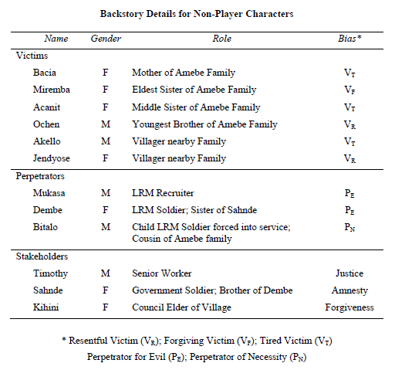
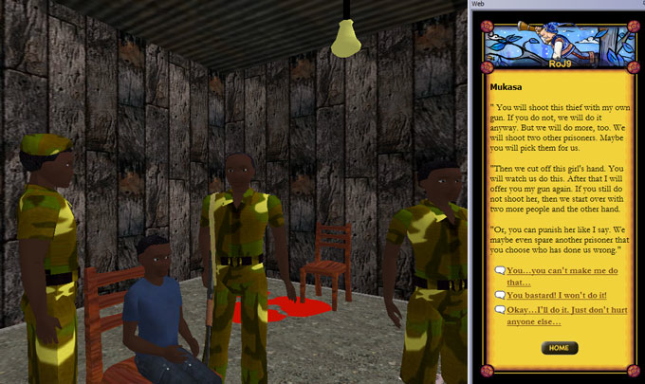
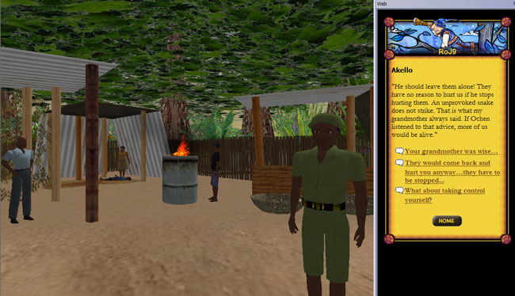
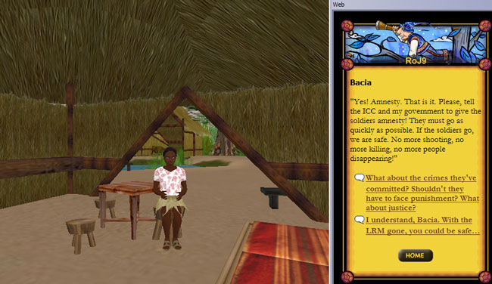

Slide 18
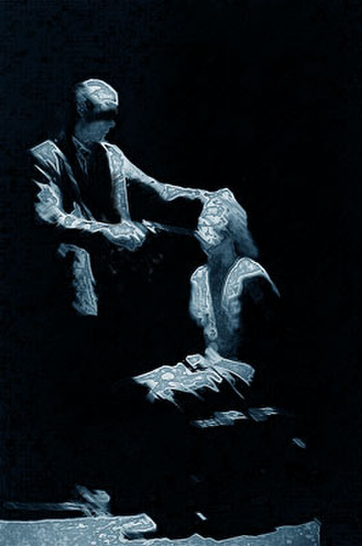
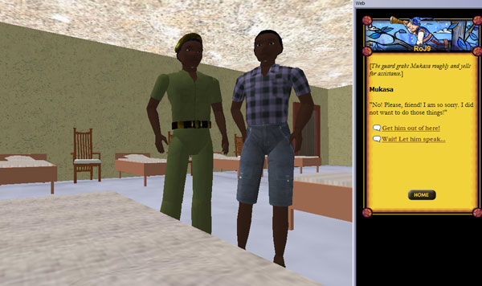
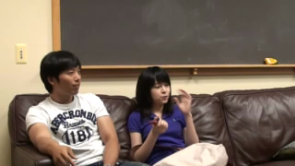


Slide 19
Player Quotes # 1
  G: “It’s funny because it shows I clearly do not have a rational theory of morality, because I said “no” when they were like ‘we’ll beat him and we’ll probably kill two people.’ We repeated that a few times, and he was like ‘hey, that’s enough. I’ll kill five people, and I’ll kill you, and we’ll kill him if you don’t do it…’”
  J: “Well, that’s because the decision is not a death for a death. It’s “do I kill somebody?” versus “do I resist?” That’s the point, and there’s a point where resistance no longer outweighs the damage that will be reaped by your resistance. Because you have to hold the gun to the kids head…
  G: Right, right.
  J: It’s not one life for one life.
  G: As much as utilitarianism makes sense to me, I couldn’t do it… It’s much more effective when you’re in this room with blood on the floor as opposed to taking a survey where it’s like “pull the lever and the trolley will kill one person and if you don’t it will kill two people.” When I’m doing that, I’m just doing math, but when I’m doing this, it’s different.

Slide 20
Player Quotes # 2
J: “It’s not as simple as peace vs. justice or amnesty vs. justice. And it’s not the same thing as living through it… But just having a decision like that that feels so embodies… it feels so real… it makes it more than an academic question in ways that talking about it just doesn’t do. Because he’s not a real boy-I’m stunned that it mattered so much.”
G: “And it wasn’t even like a Hollywood production. It wasn’t like “this was a movie that made me cry,” it was well written and everything, but I think that combined with the interactive aspect made it really powerful.”
J: “Did it feel hard for you?”
G: “Yeah! And I was similarly amazed, like “why does this feel so hard?”
---------------
you can watch [a movie] and think through “oh, that probably wasn’t the best way,” but it’s already been decided for you. You don’t have to deal with the decision.”

Slide 21
Player Quotes # 3
First of all, I have to say that I was completely blown away by the impact of this experience on how I see myself and my personal set of values. Sitting in my safe little world in middle America, I’ve read about atrocities against humanity around the world... but there was always this safe distance, not just physical but mental. I was somewhat smug in my personal self awareness, sure that, being a morally and ethically healthy person, I would never take an action that would harm another.
The feeling of helpless rage which that scene engendered in me completely changed the way I view my personal values... you might say it transformed my sense of self and the world.
I am no longer so smug in my feeling of moral superiority... and I will never forget that in the end my values didn’t protect me from being forced to take an intolerable action. To me, that is the power of this mission. All the reading I’ve done about atrocities around the world did not begin to engage my feeling of empathy in the way that a role-playing activity such as this one did, in such a short time.

Slide 22
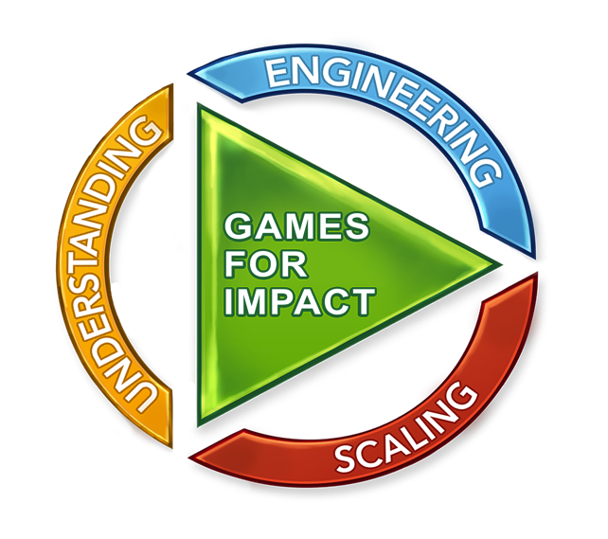
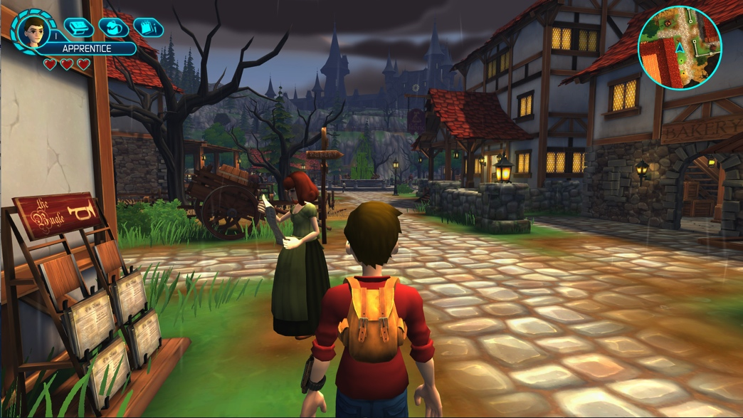
Center for Games and Impact
Directors: Dr. James Gee, Dr. Sasha Barab, Alan Gershenfeld
Bring together learning scientists, researchers, game developers and entrepreneurs … to create sustainable solutions for society’s biggest challenges.
Design Studio
Publishing Imprint
Research Laboratory
Business Services
Degree Certificate
Capacity Workshops
understand.
design.
scale.
GamesandImpact.org

Slide 23

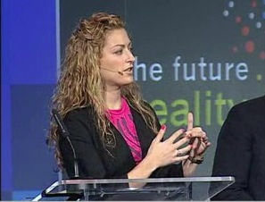
Gamification
Dettering Talk on Gamification
McGonigal on Gaming for a Better World

Slide 24

Full Life Cycle

Slide 25



Atlantis Remixed – Doctors Cure
Common Core
Persuasive Argument (WHST.6-8.1)
Text Complexity (RST.6-8.10)
Elements
Videogame
Lesson Plans
Embedded Assessment
Implementation Roles
Teacher Toolkit
Badge-Based Affinity Space
Research Infrastructure

Slide 26

Game-Infused Experience
Grade 7 (WHST.6-8.1)
Write arguments to support claims with clear reasons and relevant evidence.
  Introduce claim(s) about topic, acknowledge alternate or opposing claims, and organize the reasons and evidence logically. {GC, GS, GI, GE, TC, TS, TE}
  Support claim(s) with logical reasoning and relevant evidence, using accurate, credible sources and demonstrating an understanding of the topic or text. {GC, GS, GI, GE, TC, TI, TS, TE}
  Use words, phrases, and clauses to create cohesion and clarify the relationships among claim(s), reasons, and evidence. {GC, GS, TC, TI, TS, TE}
  Establish and maintain a formal style. {GS, TC, TI, TE}
  Provide a concluding statement or section that follows from and supports the argument presented. {GS, TC, TI, TE}

Slide 27


Embedded Assessment

Slide 28



Badge-Based Affinity Spaces
Online Communities
Social Network Support
Professional Trajectories
Monetizing PD
Access to resources
Reciprocity
Growth Trajectories

Slide 29
Game Savvy Teachers
A theoretical framework for guiding how and why we see games as potentially valuable for supporting relevancy, engagement, motivation, and deep learning.
A list of curated games that we have explored and demonstrate potential for classroom learning.
Supplemental resources/tools such as assessments, lesson plans, disciplinary connection guides, and technical guides.
Teacher professional development to support teachers in preparing to use an identified game in the classroom.
A social network to connect teachers to resources, conversations, and a community of teachers.
A badge infrastructure that rewards teacher efforts, and offers meaningful trajectories for ongoing growth.
A research methodology to support school-level and university-based efforts to understand and increase the value of the work.
A sustainable plan to ensure that participating teachers, students, and the school are able to continue to implement.

Slide 30

Example Trajectory
Gamer Mission | Play, Reflect, Deconstruct
Facilitator Mission | Plan, Implement, Evaluate
Transfer Mission | Translate, Support, Impact
--------
4a. Modder Mission | Modify, Activate, Share
4b. Mentor Mission | Connect, Initiate, Collaborate

Slide 31

Cook Inlet Tribal Council
We envision a future in which all Our People, especially Our youth, the stewards of our future, have access to vast opportunities, and have the ability, confidence, and courage to advance and achieve their goals, infused with an unshakeable belief in Our endless potential.

Slide 32


Center for Games and Impact
Directors: Dr. James Gee, Dr. Sasha Barab, Alan Gershenfeld
Bring together learning scientists, researchers, game developers and entrepreneurs … to create sustainable solutions for society’s biggest challenges.

